Slide 1
Justice Sector Institutional Strengthening Project - Strengthening Forensic Expertise Contract No.KZJSISP/QCBS-06
Component C: Advanced training of forensic experts

Slide 2
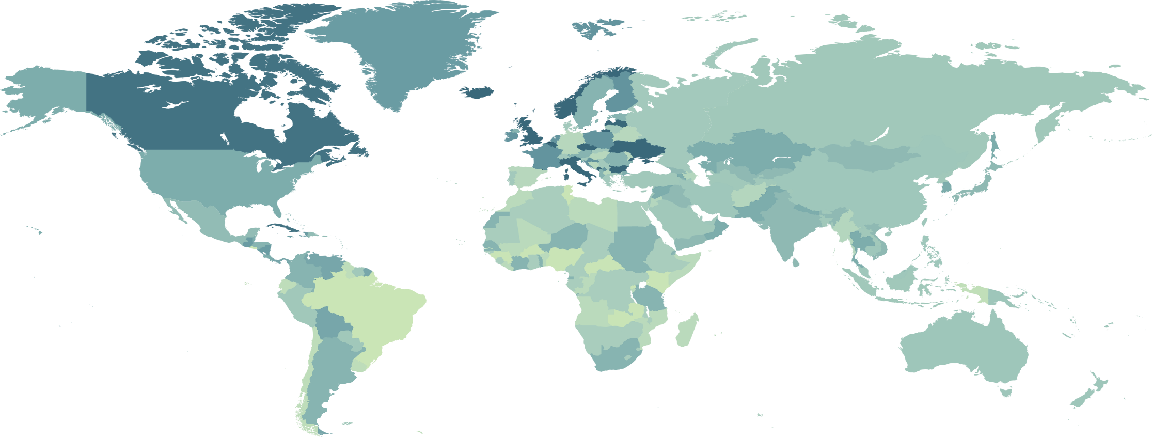
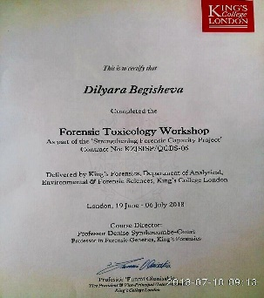
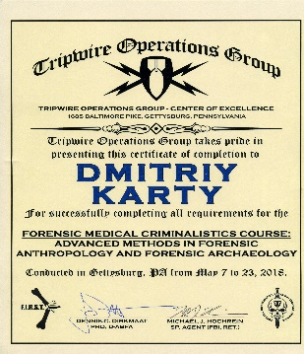
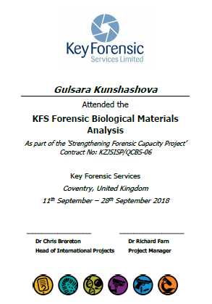
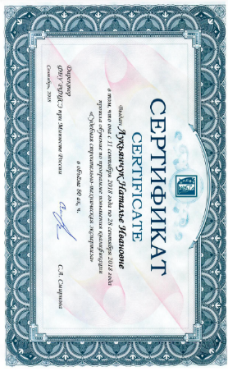
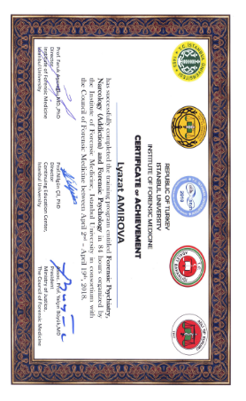
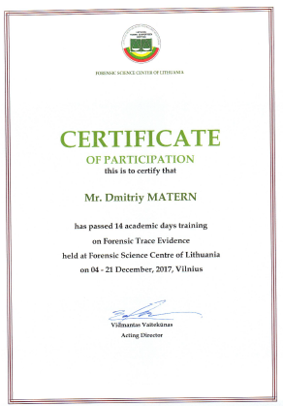
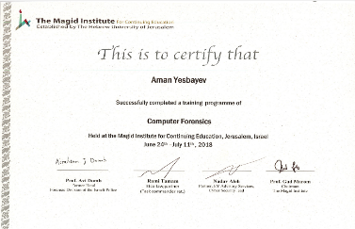
21 types of expertise, 211 forensic experts
Forensic Science Centre, Lithuania
- Trace evidence
- Hadwriting
КСL and KFC, UK
- Chemistry
- Drug testing
- DNA
- Toxicology
- Biology
RFCFE, Russia
- Construction and engineering
- Ecology
Tripwire, US
- Medical Criminalistics
- Fire and explosion
Tripwire, США
- Мед.криминалистика
- Пожары и взрывы
Austability, UAE
- Linguistics
Institute of Forensic Sciences, Turkey
- Narcology
- Voice and Speech
- Psychiatry/Psycology
- Histology
- Pathology/Autopsy
- Clinical medicine
MAGID University,
Israel
- Accidents
- Computer
- Accounting
2

Slide 3
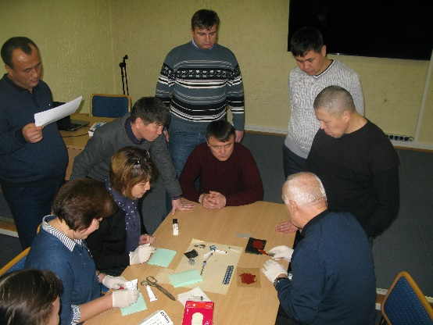
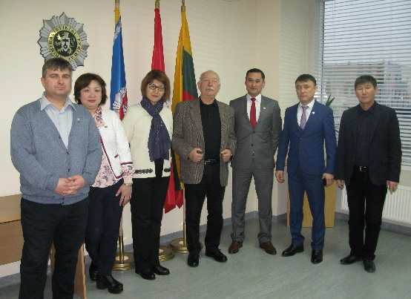
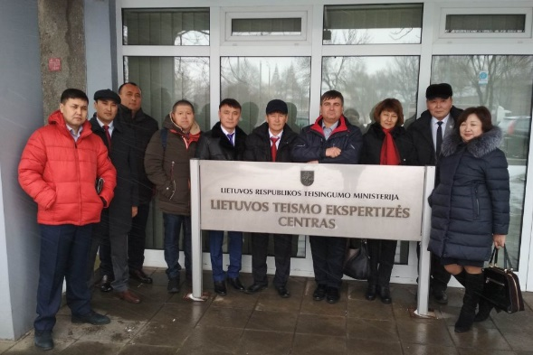
Forensic Science Centre of Lithuania (FSCL)
governmental institution of public administration — MoJ of Lithuania
founded in 1955
is certified according to LST EN ISO/IEC 17025 standard for stamp, stamp impressions, fibres, a wheel with a pneumatic tyre, handwriting and signatures, fingerprints, paints, bullets analysis
Member of ENFSI since 1995
Handwriting Analysis
05.03. 18 – 22.03.18
10 forensic experts
Forensic Trace Evidence
04.12.17 – 21.12.17
10 forensic experts
The main activities:
Forensic examinations;
Research and methodical work;
Training of experts and recognition of qualifications.
3

Slide 4
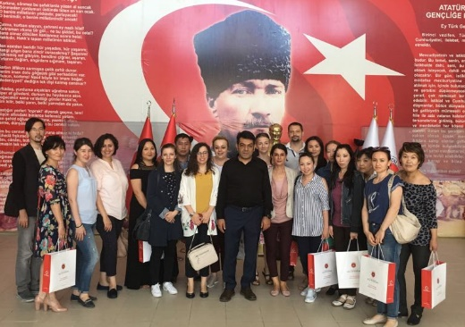
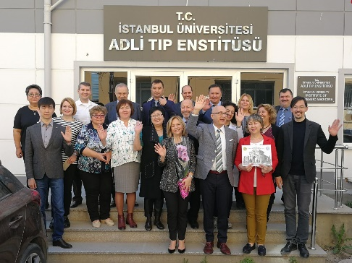
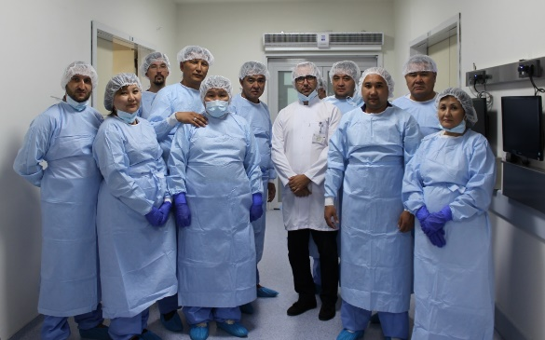
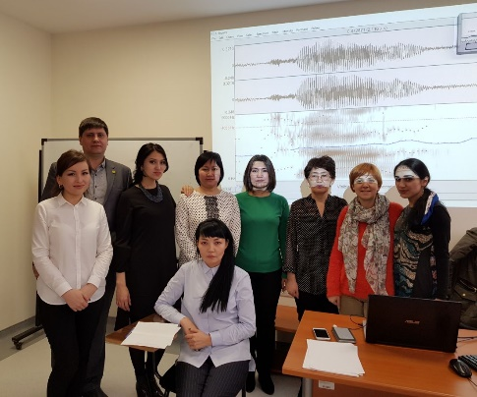
Institute of Forensic Sciences and Legal medicine Istanbul University (ATE)
Leading institution in the field of scientific research and forensic development.
founded in 1982 (Istanbul University — in 1453).
certified with ISO/IEC 17025 since 2012
Member of ENFSI since 1999
Forensic Histology
15.05.18 – 01.06.18
13 forensic experts
The main activities:
Education and Training
Scientific Research
Scientific Meetings
Scientific Counseling
Expertise Services
Laboratory Services
Graduates
Publications
Projects
Forensic Histology
15.05.18 – 01.06.18
13 forensic experts
Forensic psychiatry/psycology
Forensic narcology
02.04.18 – 19.04.18
10 forensic experts
Forensic Pathology/Autopsy
Clinical forensic medicine
18.06.18 – 05.07.18
15 forensic experts
Voice and Speech Analysis
29.01.18 – 15.02.18
10 forensic experts
4

Slide 5
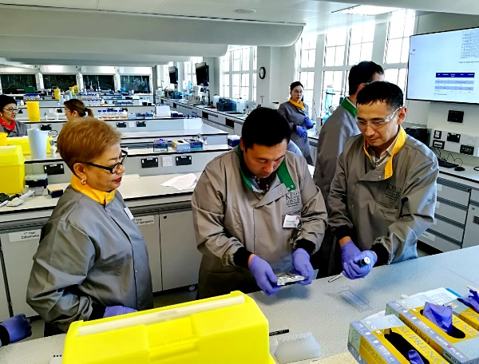
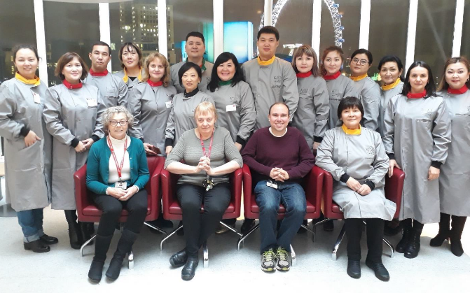
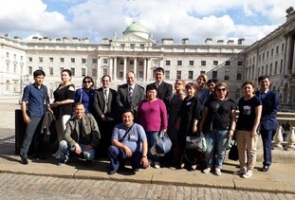
King`s College London(KCL) Department of Forensic Science
founded in 1829 (forensic department since 1985).
In Top-8 Universitites of Europe; 21 in the world ranking of Universities;
BA, MA and PhD programs in forensic studies
Programs accredited by Chartered Society of Forensic Science
The main activities:
theoretical and practical education
forensic expertise for International Olympic Committee
Scientific and research activities sponsored by the Ministry of Internal Affairs
Cooperation with laboratories, police and Ministry of Defense
Forensic Toxicology
19.06.18 – 06.07.18
14 forensic experts
Forensic DNA
Analysis
04.12.17 – 21.12.17
15 forensic experts
5

Slide 6
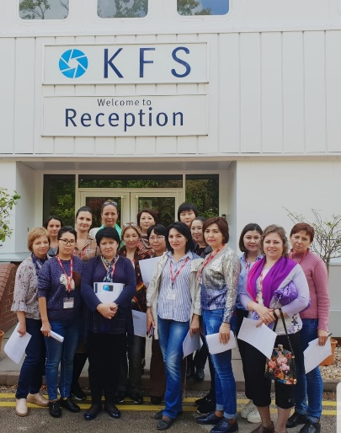
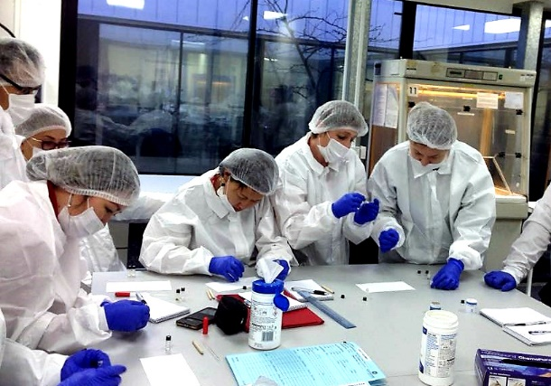
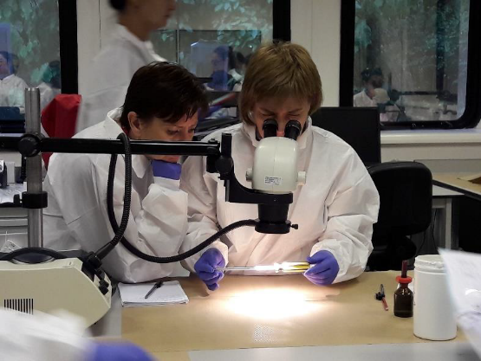
Key Forensic Services LTD (KFS)
The biggest private laboratory of Great Britain.
Founded in 1992.
Accredited with ISO 17025 and ISO9001.
All services are underpinned by a significant Research and Development programme
Member of ENFSI
The main activities:
forensic training services
expertise to design, build and resource new laboratory facilities, update existing laboratories or manage laboratory expansion programme
contracted to provide specialist services to the majority of police forces in England and Wales.
consultancy service for Governments, forensic laboratories and law enforcement agencies anywhere in the world
Forensic Chemistry
Drug Testing and Analysis
14.11.17 – 01.12.17
15 forensic experts
Biological Materials Analysis
11.09.18 - 28.09.18
15 forensic experts
6

Slide 7
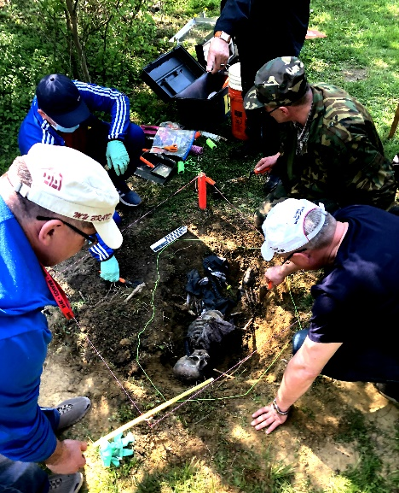
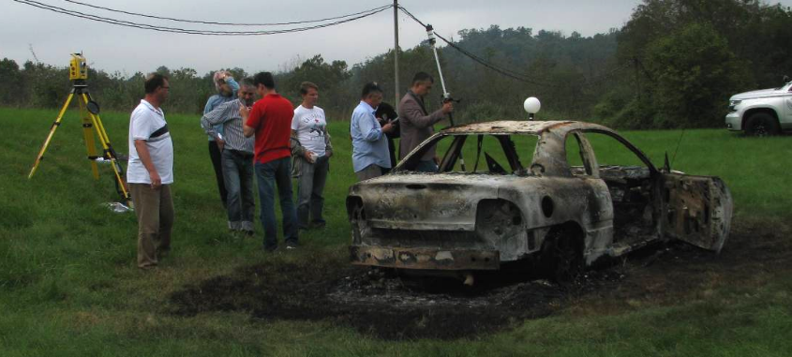
Tripwire Operations Group LLC
american consulting company.
ATF licensed explosive materials manufacturer, importer, exporter and dealer.
Forensic Investigations, Research, Services, and Training (F.I.R.S.T) - Forensic division
advanced and well-equipped facility for running crime scene reconstructed experiments and trainnings.
certified by SBA and registered by SAM
The main activities:
tactical Explosive Breaching Certification
provides security, investigative, intelligence, training, and operational advisory assistance, support, and solutions to law enforcement agencies and military units
a wide variety of services focused on forensic scene recoveries (outdoor and indoor), mass disaster incidents, forensic DNA interpretation, forensic anthropology cases, and general criminalistics.
Forensic Medical Criminalistics
07.05.18 – 23.05.18
8 forensic experts
Forensic Fire and Explosion
24.09.18 – 11.10.18
7 forensic experts
7

Slide 8
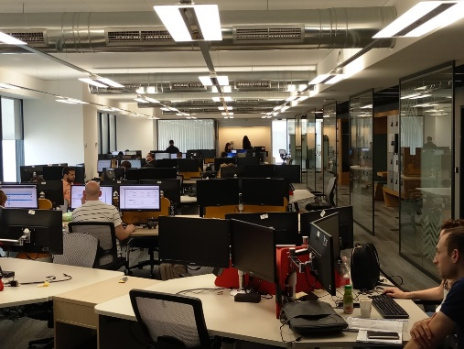
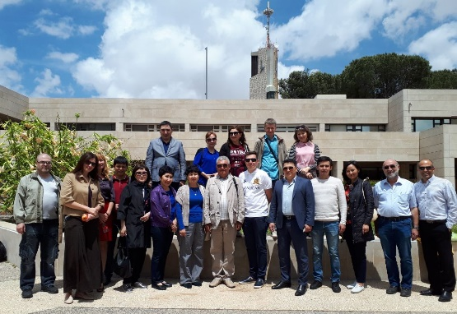
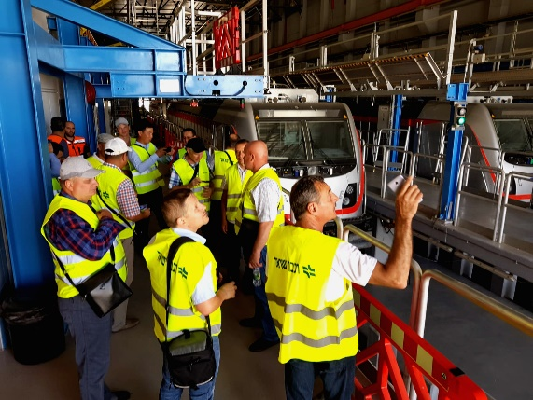
The Magid Institute for Continuing Education Hebrew University
founded by the Hebrew University to provide a flexible framework for advanced professional trainning.
Over 200 majors and programs and over 5,000 courses at Hebrew University
9,826 patents; 2,753 inventions (150 per year); 600 commercial products; 880 licenses and 120 spin-off companies
Forensic Accounting
13.05.18 – 31.05.18
16 forensic experts
Computer Forensics
24.06.18 – 11.07.18
10 forensic experts
The main activities of Magid Institute:
Continuing education and certification for graduates and professionals;
Training for employees of various public and private sector institutions;
University preparatory school for specific populations;
Executive programs of the Hebrew University.
Hold workshops, conferences and seminars.
Accident Analysis
and Reconstraction
03.06.18 – 20.06.18
12 forensic experts
8

Slide 9
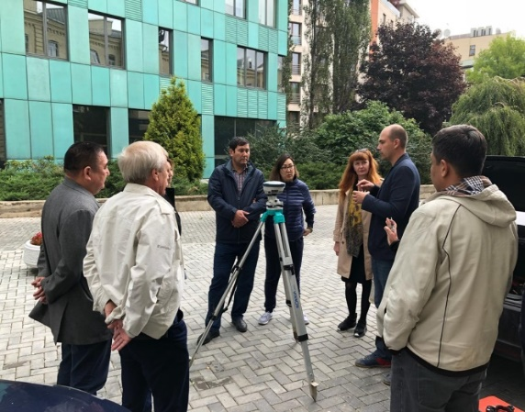
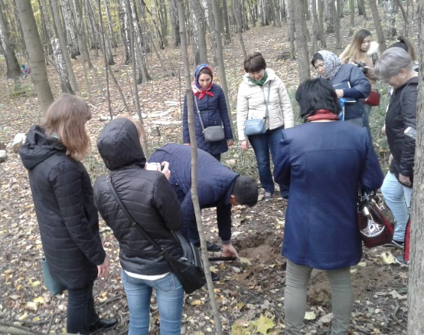
Russian Federal Center of Forensic Expertise of the Ministry of Justice of Russian Federation
a federal budget institution
works within the framework of the SCO, ENFSI and other international institutions in different countries
accredited according to ISO 17025
a member of ENFSI since 2005
provides expertise in 24 forensic fields.
Forensic Construction
and Engineering
11.09.18 – 28.09.18
10 forensic experts
Forensic Ecology
08.10.18 – 25.10.18
10forensic experts
The main activities:
forensic examinations in criminal, civil, arbitral and administrative cases, forensic examinations and expert research verifying a crime report;
training and certification of forensic institutions’ employees in areas of forensic exertise.
scientific and methodological support including development of new types of forensic examinations; training, professional development and certification of workers; conducts internships for experts.
9

Slide 10
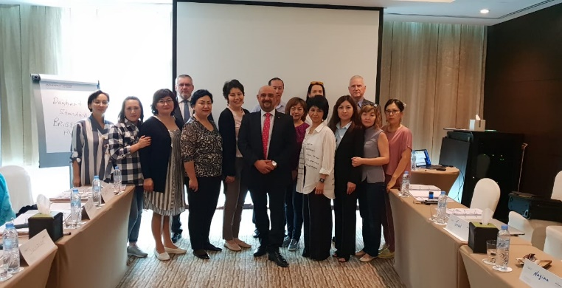
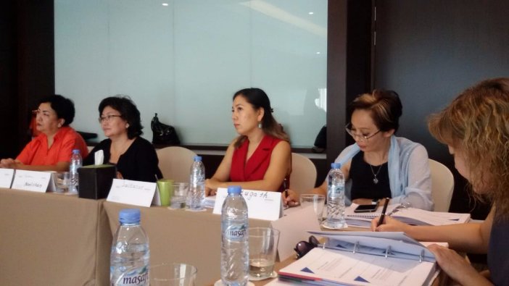
Austability
Australian consulting company.
provides range of Capacity Building concepts and programs since 1989
access to over 650 experts from the five eyes countries (Australia, New Zealand, United Kingdom, Unites States and Canada) across various disciplines in the counter terrorism and related transnational crimes.
The main activities:
Design and delivery of customised competency and knowledge enhancement programs aligned with the Australian Quality Training Framework
Setting operational effectiveness benchmarks
Building operational effectiveness via strategic partnerships and operational support
Forensic Linguistics
14.10.18 – 29.10.18
11 forensic experts
10

